Slide 1
RV College Of Engineering
Yoga Diet and Nutrition
Exploring the harmony between mindful
movement and mindful eating

Slide 2
Presented by Our Team (CH-A)
Adishwar Tripathi
Aryan Lodha
Nehal Karjagi
Vedant Sud
1RV24CH002
1RV24CH007
1RV24CH026
1RV24CH040

Slide 3




Yoga, Dietetics, and Nutrition
Yoga Practice
Promotes physical and mental well-being.
Better Digestion
Yoga enhances bodily functions.
Nutrient Absorption
Improved uptake for energy and recovery.
Mental Calm
Holistic health through mind-body connection.

Slide 4
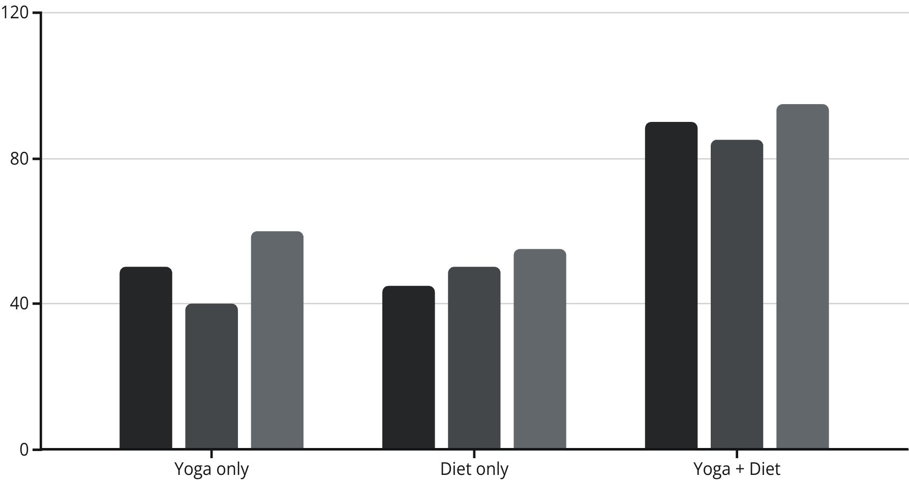
Why Combine Yoga and Nutrition?
Yoga optimizes bodily functions; nutrition fuels them efficiently.
Body needs adapt to diverse yoga practices.
Mindful eating extends mindfulness beyond the mat.
Sleep Quality
Digestion
Energy

Slide 5

Scientific Research & Data
Yoga Only
1.8 kg
↓10%
+20%
Diet Only
2.3 kg
↓12%
+15%
Both
4.1 kg
↓30%
+40%
Harvard Study (2020) confirms yoga and diet double stress reduction. NIH Study (2019) shows mindful eating and yoga significantly reduce BMI. This data highlights the powerful synergistic effect.

Slide 6
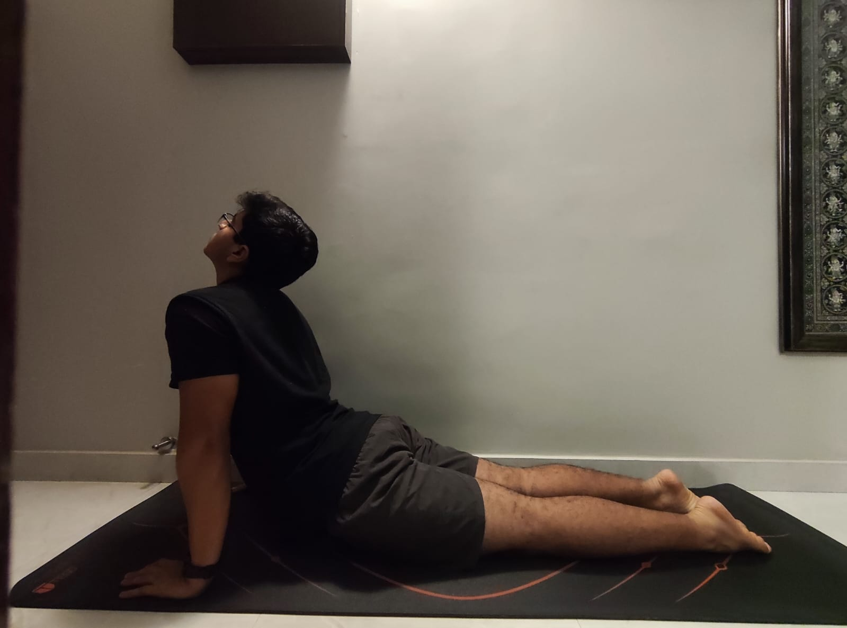
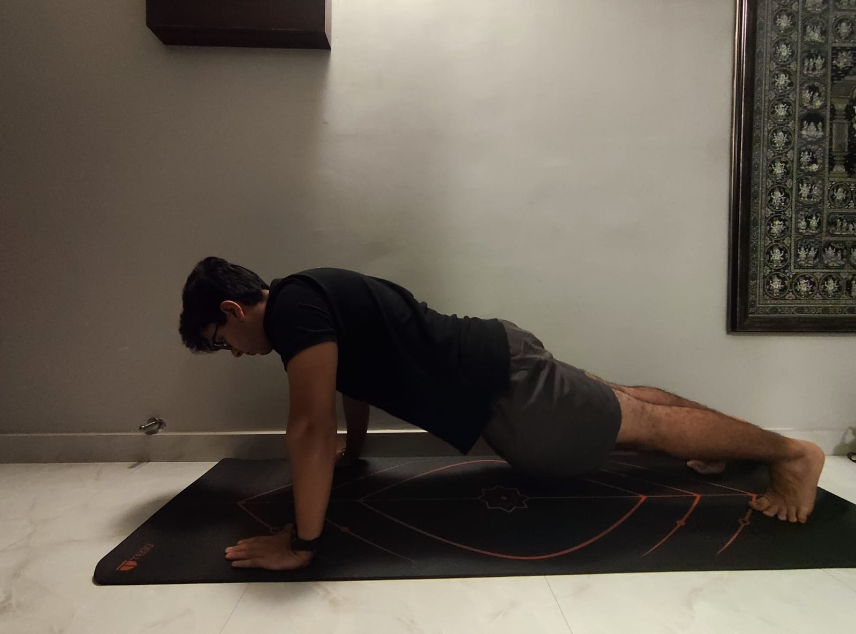
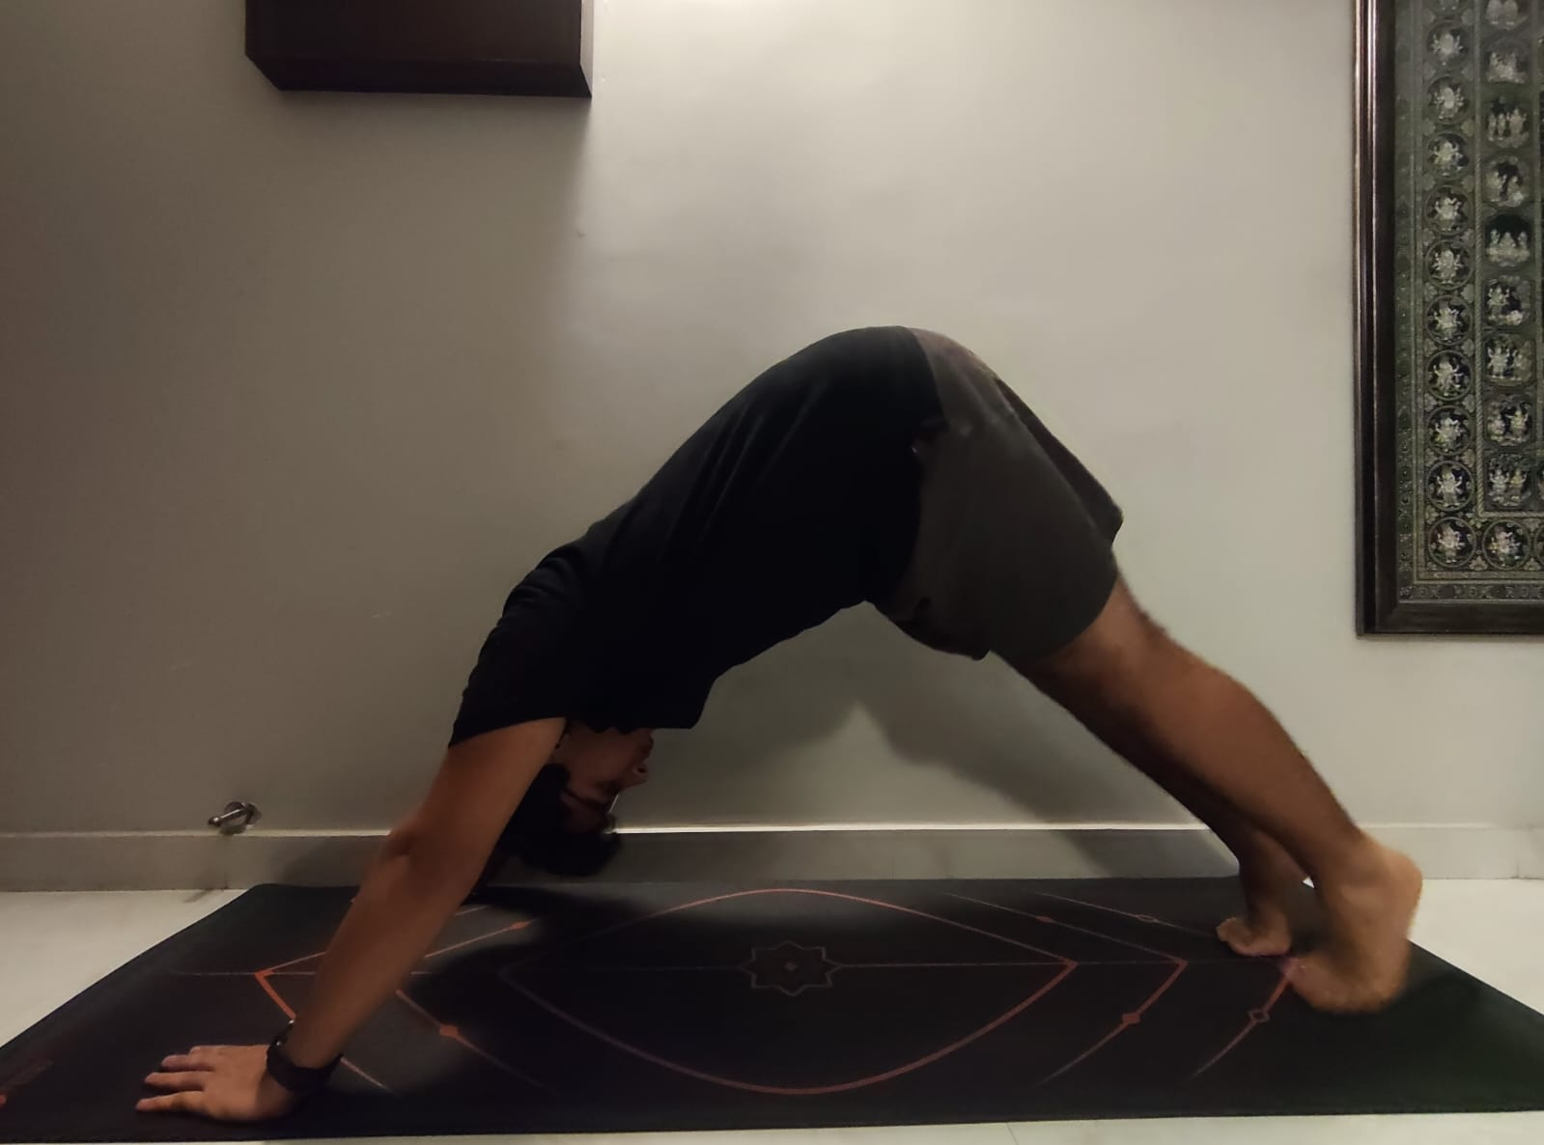
Yoga Poses and Their Diet Connection :-
Cobra Pose
Improves posture and digestion.
Pre-yoga tip: light banana or herbal tea.
Plank Pose
Builds core strength and boosts metabolism.
Post-yoga tip: protein smoothie or nuts.
Downward Dog
Enhances blood flow and stretches the body.
Hydration is key before and after.

Slide 7

Sample Daily Yoga Nutrition Plan
6:30 AM | Pre-Yoga | Warm Water + Banana
8:30 AM | Breakfast | Oats, Fruits, Soaked Almonds
1:00 PM | Lunch | Brown Rice, Dal, Vegetables
5:00 PM | Snack | Nuts or Fruit Smoothie
8:00 PM | Dinner | Khichdi, Curd, Veggies
Fats
Proteins
Carbs
Carbs
Proteins
Fats

Slide 8
Conclusion
Interdependent Lifestyle
Enhanced Performance
Sustainable
Wellness
Yoga and nutrition create a healthy, symbiotic lifestyle.
Right food choices boost flexibility, endurance, and focus.
Mindful nutrition combined with yoga leads to lasting well-being.
"Yoga is the journey of the self, through the self,
to the self – fueled by the right diet."

Slide 9





References
Harvard Medical School
NIH Study
Comp & Integrative Medicine
nih.gov
health.harvard.edu
Journal, 2020
Yoga Journal
yogajournal.com

Slide 10
Thank you 🙏

